Slide 1

KAVYA RANE
KOHLER MITWPU
Case study 1
BUILD AN INTERACTIVE AI DESIGN ASSISTANT THAT TAKES A CUSTOMER'S CONSTRAINTS AND AUTOMATES PERSONALIZED PRODUCT BUNDLE RECOMMENDATIONS.
AI RESEARCH PROGRAM
Name: Kavya Rane
Year: Third (2024-2028)
PRN: 1262241582
Panel: B
BTech CSE (AI/DS)

Slide 2
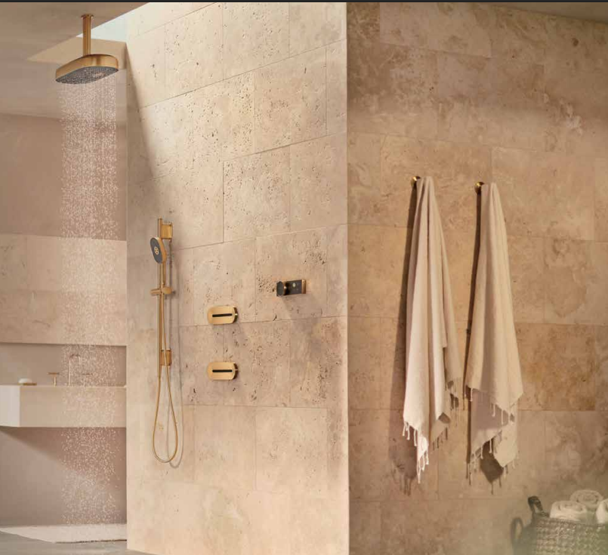
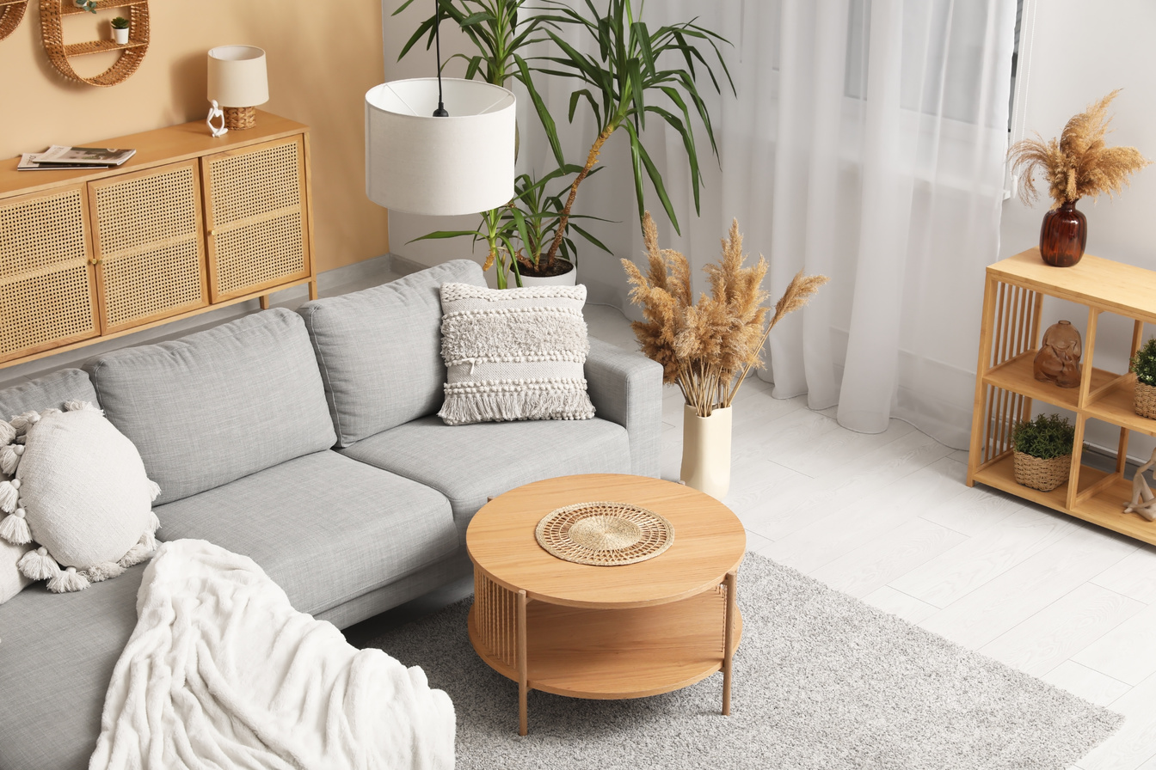
Problem Statement
Customers often struggle to identify the right bathroom and kitchen products for their specific requirements because product selection depends on multiple factors such as the exisiting fixture, the issue or replacement need, available space, dimensinos,budget and preferred finish. Manually searching through large product catalogs and price books can be time-consuming and can lead to unsuitable product choices.
Therefore, there is a need for an AI-powered system that can analyse an image of an exisiting bathoom or kitchen fixture, identify the fixture and possible issue, collect the user’s space and budget requirements, and reccomend suitable KOHLER products based on the product specifications, dimensions, compatibility and price.
NEED:
AN INTELLIGENT SYSTEM THAT CAN ANALYSE THE EXISITING FIXTURE AND
RECOMMEND SUITABLE KOHLER PRODUCTS BASED ON THE USER’S ACTUAL REQUIREMENTS
COMBINING AI-BASED VISUAL ANALYSIS TO SIMPLIFY BATHROOM AND KITCHEN PRODUCT SELECTION

Slide 3
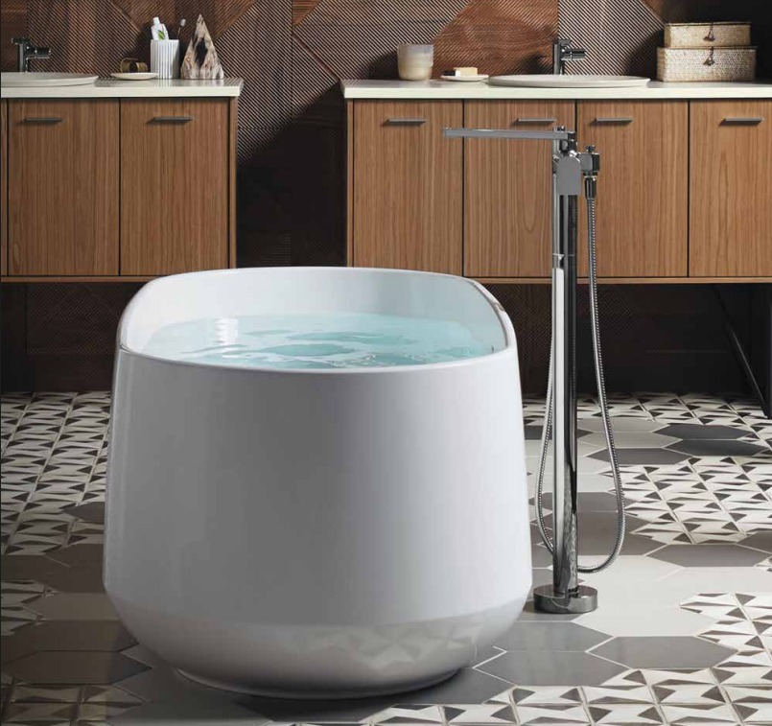
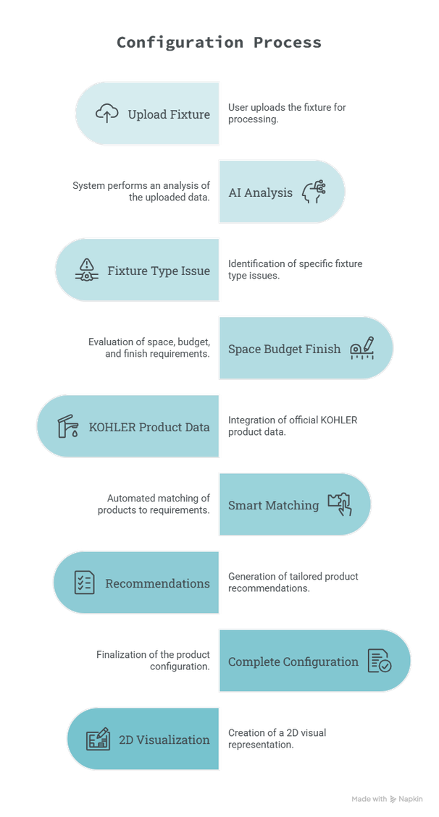
SOLUTION
AN AI-powered reccomendation system that understands the user’s existing fixture, requirements and availbale space, then identifies suitable KOHLER products from the product catalog
PRODUCT EXPERIENCE
  Scan & Understand
  Tell us about your space
  Get personalized recommendations
  Build the complete space
  Visualize the space

Slide 4
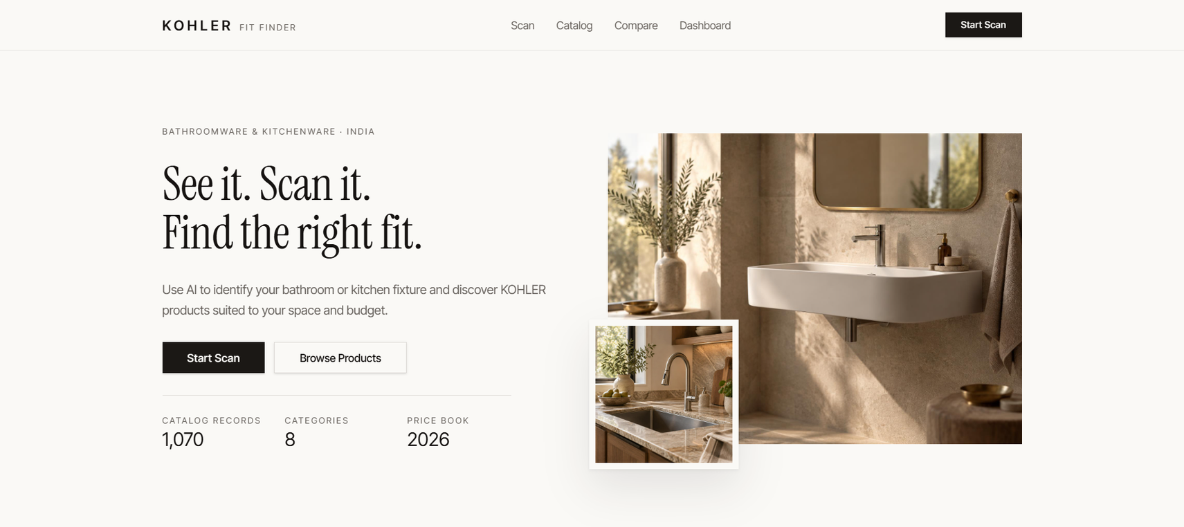
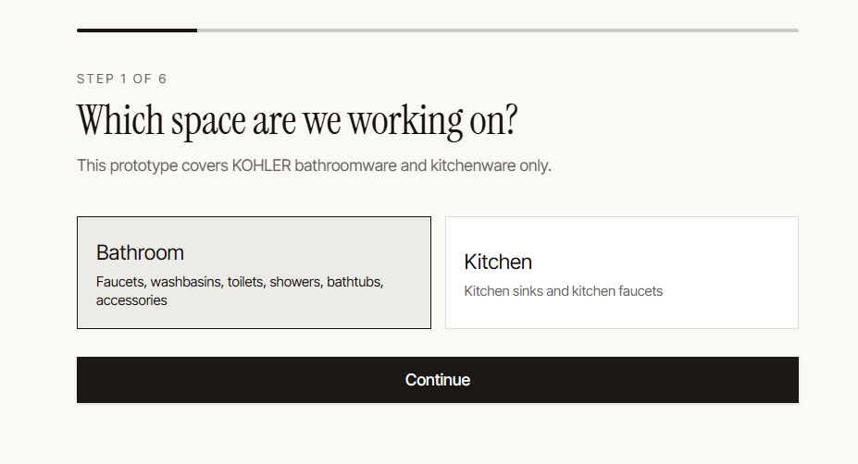
SCAN AND UNDERSTAND
Our AI analyzes the image to identify
  Fixture type- eg toilet, washbasin, faucet, sink
  Possible issue- eg leakage, damage, crack, corrosion
  Detection confidence- indicates the model’s confidence in its analysis
User confirmation
The detected fixture and issue are presented to the user for confirmation before generating reccomendations

Slide 5
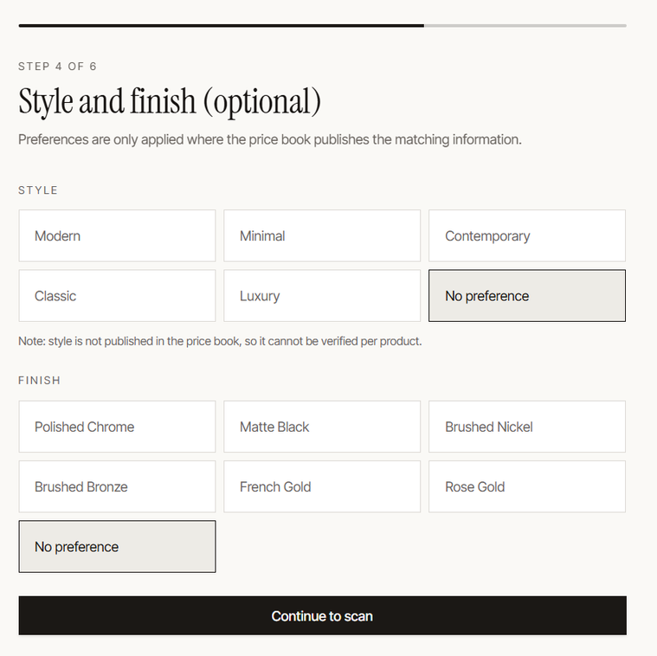
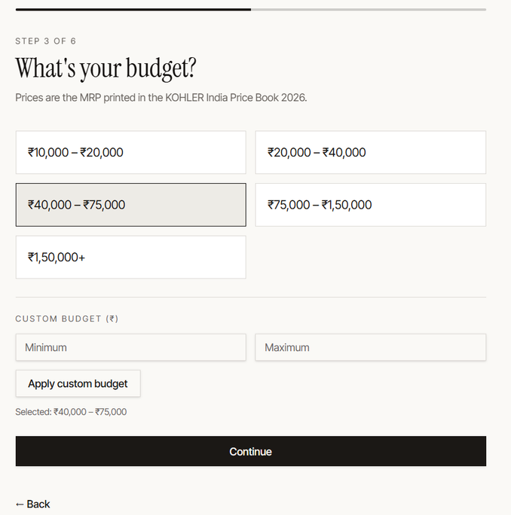
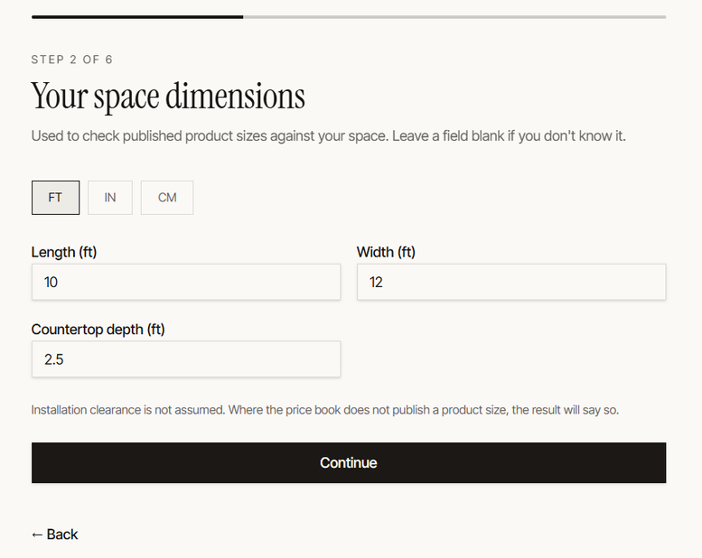
TELL US ABOUT YOUR SPACE
Personalize Reccomendations to Your space
After identifying the fixture, the user provides key requirements that influence product selection.
Space requirements
  Room length and width
  Room height, where applicable
  Countertop depth for kitchen spaces
User preferences
  Budget range
  Preferred Style
  Preferred finish
The recommendation is based on the user's actual space and requirements — not just the product category.

Slide 6
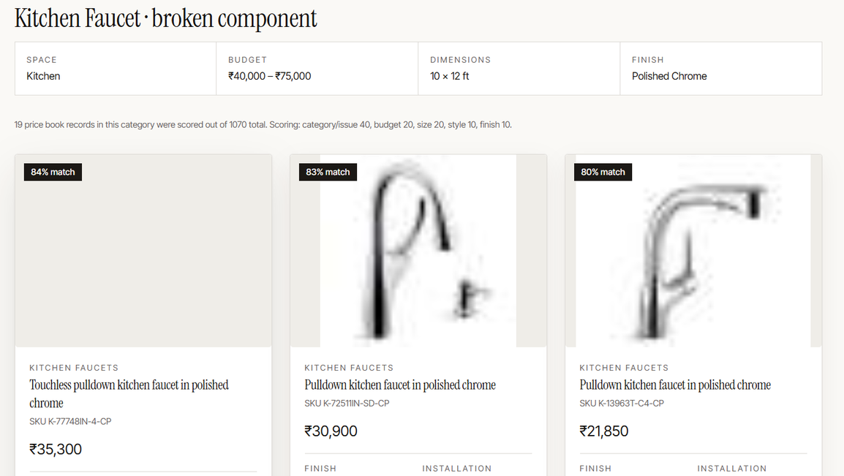
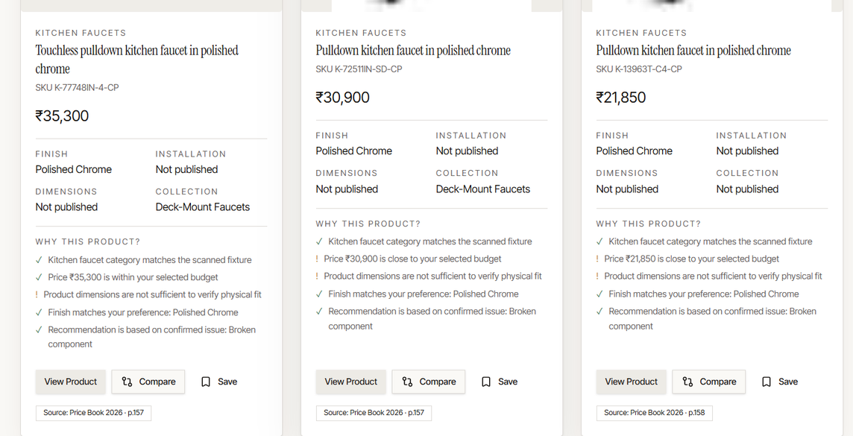
GET PERSONALIZED RECCOMENDATIONS
Products are evaluated using:
  Fixture/category relevance
  Confirmed issue
  Budget compatibility
  Available space
  Product dimensions
  Finish preference
  Available product information
The system doesn't simply search the catalog — it filters and ranks products according to the user's requirements.
Product Name | SKU | Price | Match Score | Reasons

Slide 7
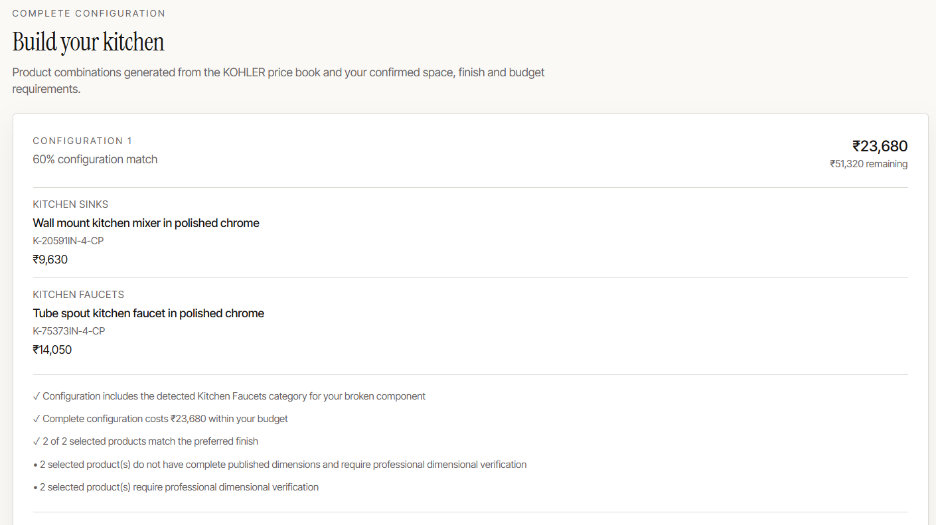
BUILD A COMPLETE SPACE
Instead of recommending only an individual replacement product, the system can generate complete bathroom and kitchen configurations

Slide 8
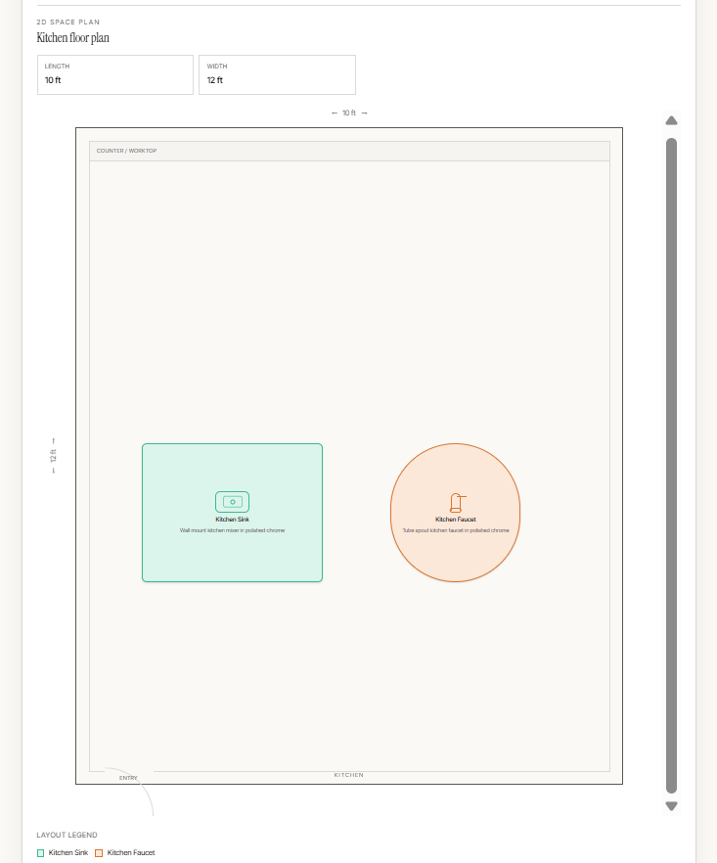
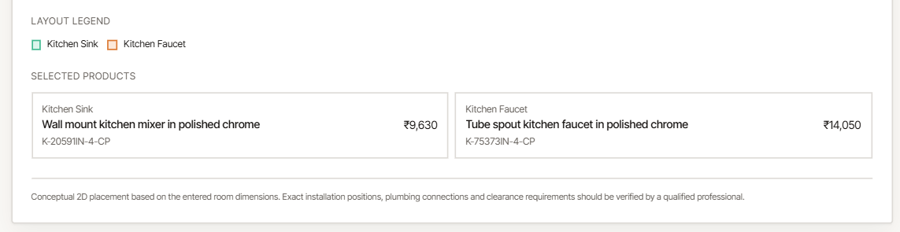
VISUALIZE THE RECOMMENDED PRODUCTS
The system generates an indicative 2D layout of the bathroom or kitchen. The visualization considers:
  User-provided room dimensions
  Product categories
  Published product dimensions
  Product footprint scaling
  Space type
Help users understand how the recommended products relate to the available space before making a product decision.

Slide 9
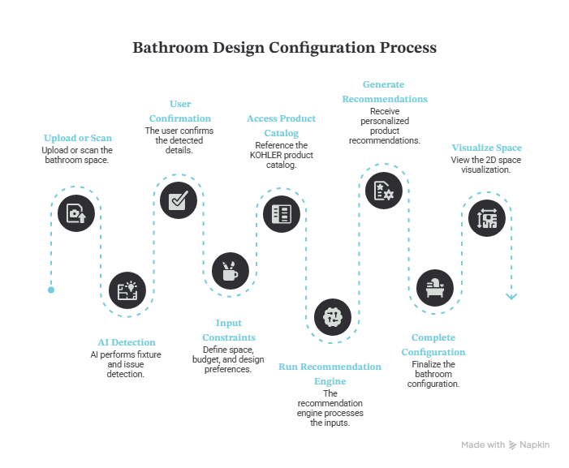
FROM PROBLEM TO PERSONALIZED SOLUTION

Slide 10
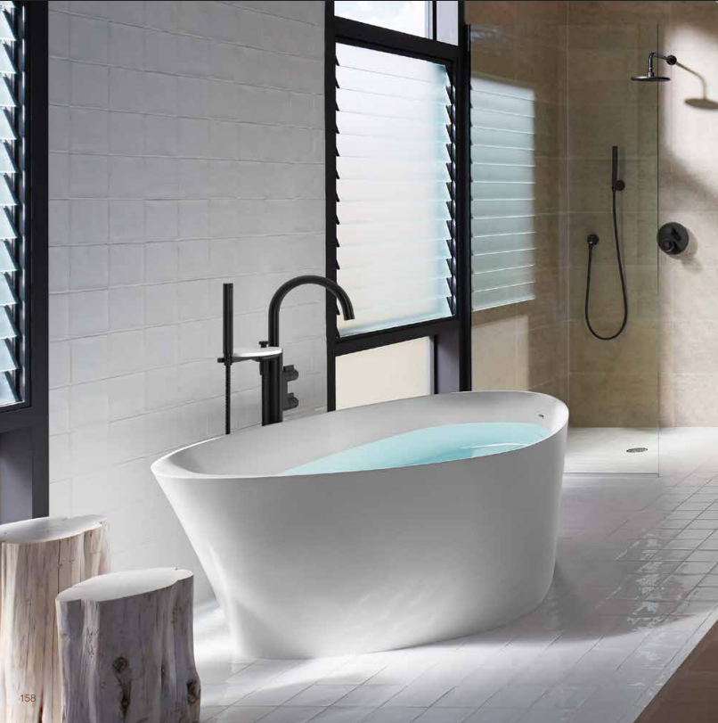
THANK YOU

